Slide 1

Research on a fuck Multiphysics Coupling
C Q
Research Center of Satellite Technology
caoqian10086@gmail.com caoqian10086@outlook.com

Slide 2
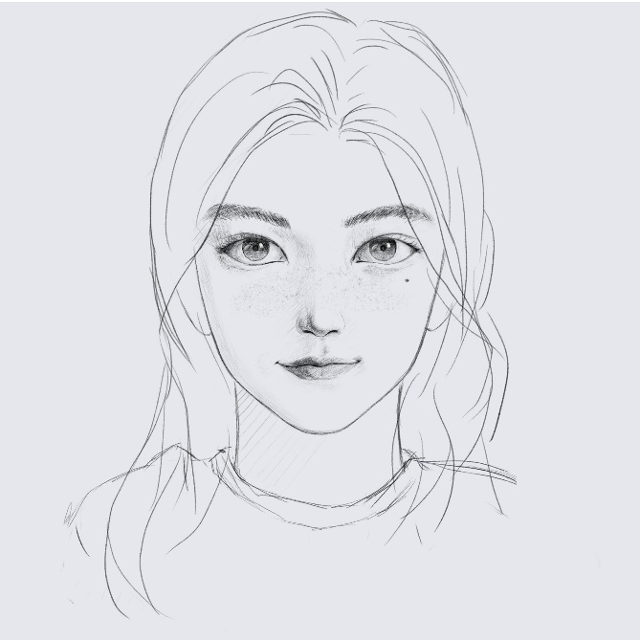
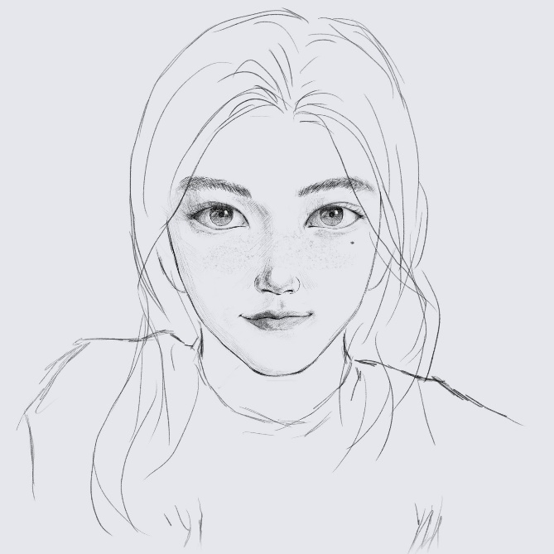
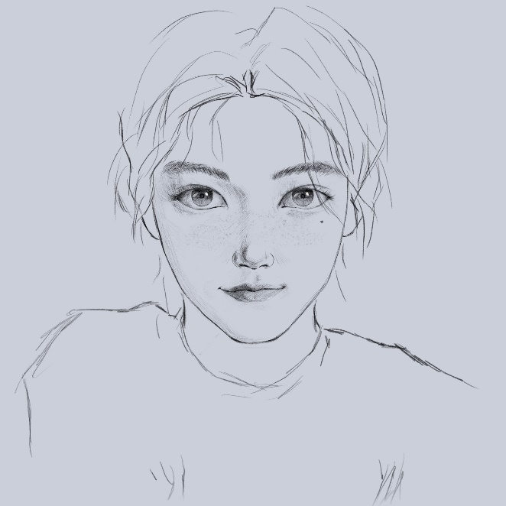
Background
Domain adaptation
Training set 1
Training set 2
Test set

Slide 3
Theory
Domain adaptation error bound

Slide 4
Theory
Adaptation error bound

Slide 5
Theory
Domain generalization error bound

Slide 6
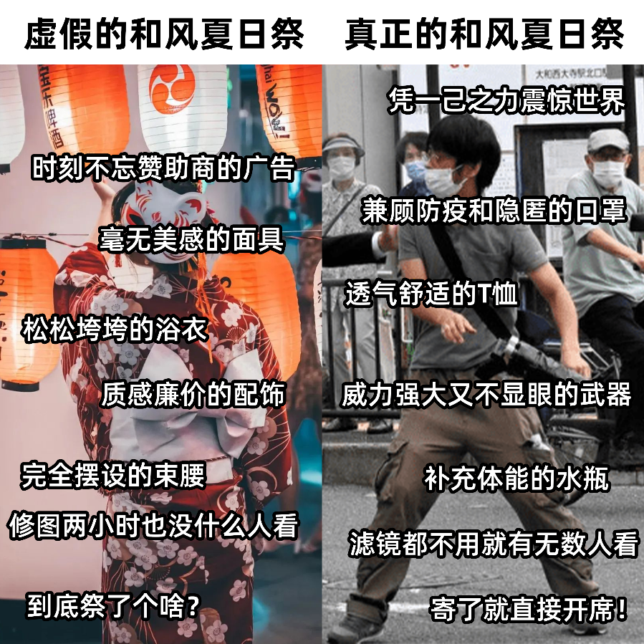

Methodology

Slide 7
Data manipulation
Data 1
Insdaase ssality and quasy

Slide 8
Thanks
hit_cq@hit.edu.cn

